Slide 1

ASP.NET Core 2.0 & MVC6 New Features
David Revoledo
CEO
DGenix

Slide 3

About me !
David Revoledo| @deirevoledo
CEO – DGenix
Net Tech Lead
Specializes in ASP.NET & JavaScript
Experience in .NET training
Clean coder, Microsoft fanatic, Avid learner

Slide 4

Agenda
ASP. Net History
ASP. NET MVC 6 New Features
Demo
What’s next

Slide 5
Setting Expectations - Target Audience
.NET Developer who is new to web development
Web developer who is new to .NET
ASP.NET Developer who wants to learn ASP.NET Core (MVC6)

Slide 6
A little about ASP. NET history

Slide 7
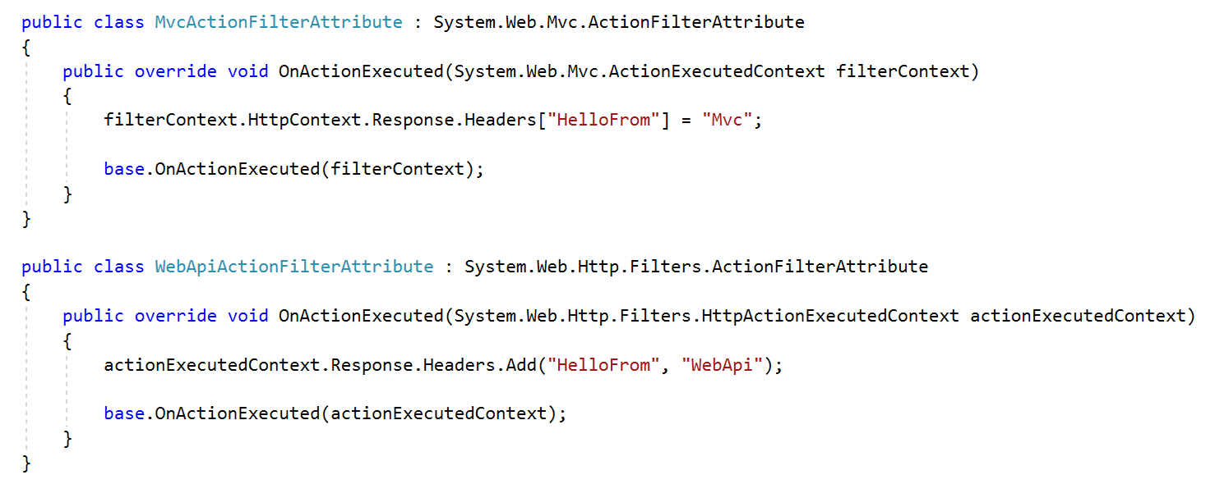
Asp.Net WebApi & Mvc Playing Togheter

Slide 8
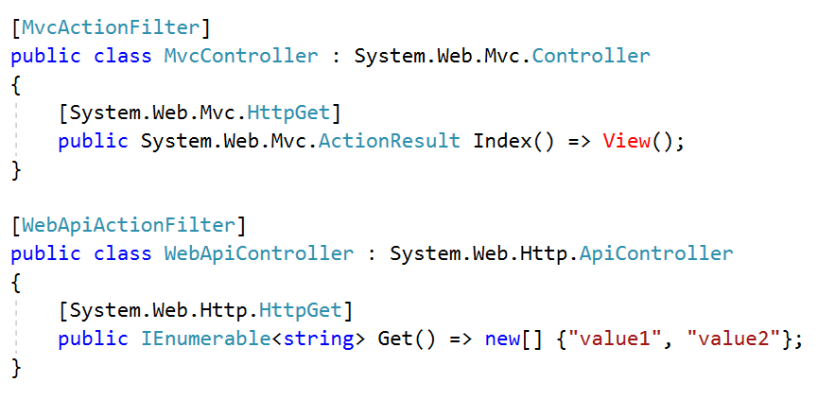
Asp.Net WebApi & Mvc Playing Togheter

Slide 9
Asp.Net WebApi & Mvc Playing Togheter
Duplicated configuration
Strong Dependency to System.Web
Duplicated Objects/Behavior

Slide 10
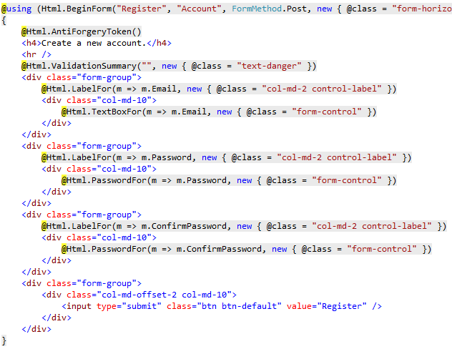
Typically Razor Form

Slide 11
While the Design team & UI Devs:
Missing intellisense over Html & CSS
UI code not so much readable
Not the same approach like all the UI web components popular frameworks

Slide 12

While the Design team & UI Devs:

Slide 13
Asp.NET Core & .NET Core
ASP. Net Core & NET .Core & EF. Core play very well together
BUT
ASP.NET Core <> NET .Core
ASP.NET Core <> Entity Framework .Core

Slide 14
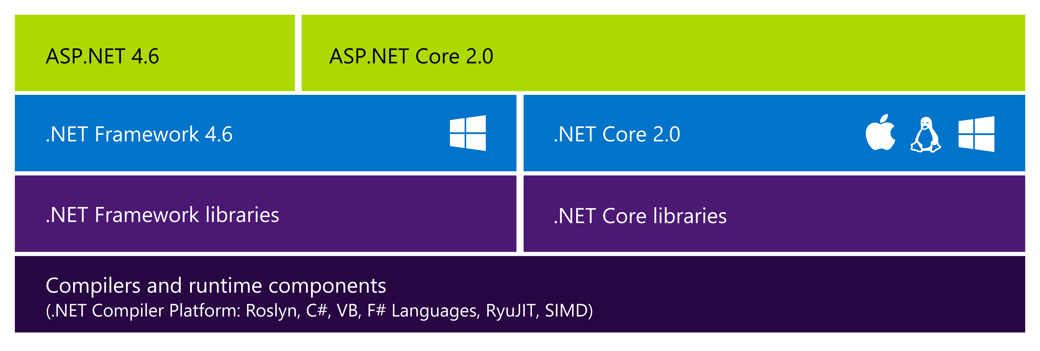
ASP.NET 4.6 and ASP.NET Core 2.0

Slide 15
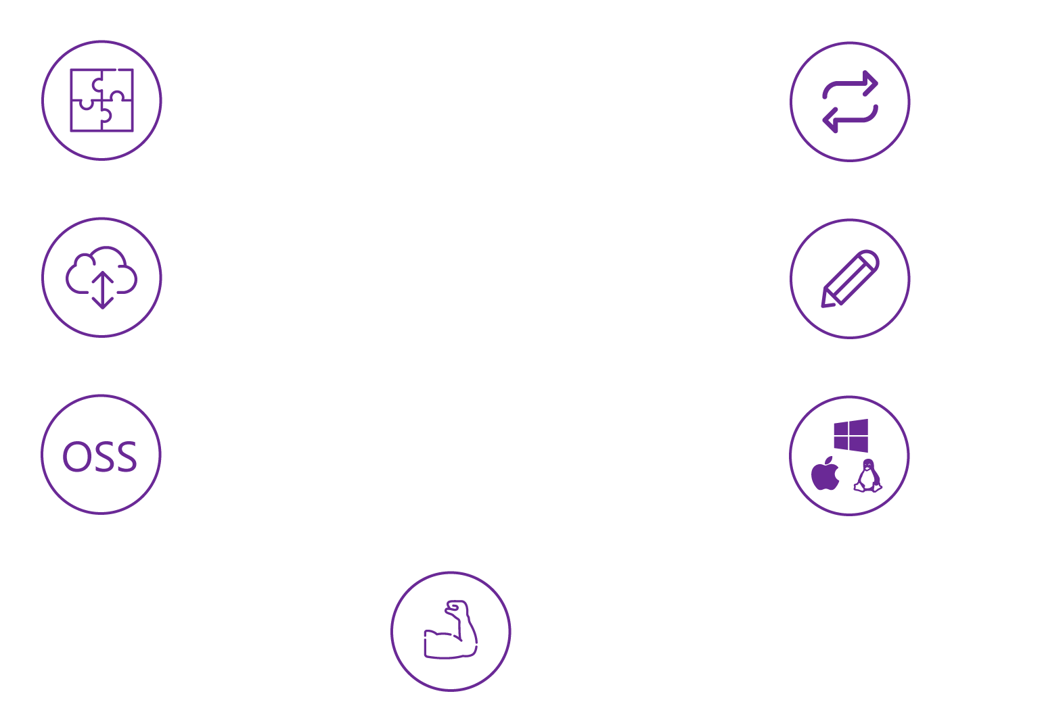
ASP.NET and the Modern Web
Totally modular
Faster development cycle
Seamless transition from on-premises to cloud
Choose your editors
And tools
Open source
With contributions
Cross-platform
Fast

Slide 16
ASP. Net Core
Net Core Is awesome, multiplatform and has a EXTREME performance improvements.
But…. it isn’t strictly necessary migrate to Net.Core to migrate an existing asp.net MVC/WEBAPI application

Slide 17
Asp Net MVC 6 - What’s new ?
ASP.NET MVC on OSX and Linux
No More Web Forms
Tag Helpers
View Components
Razor Pages
Built-in dependency injection.
Unified MVC and Web API Controllers
Razor view compilation

Slide 18
What are Tag Helpers ?
Tag Helpers allow server-side code to participate in rendering of HTML elements in Razor files.
Target Html elements based on the element and attribute names.
Reduce the explicit transition between HTML and C# in Razor files.
Take advantages of the composition and tooling benefits of HTML in Visual Studio.

Slide 19
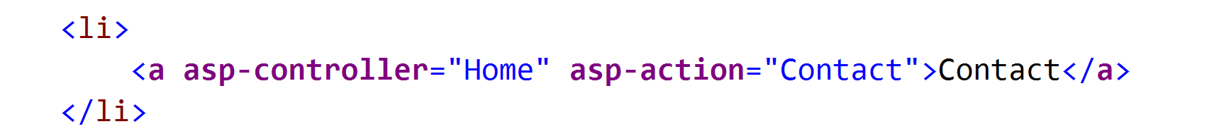
Using tag helpers
Asp.Net MVC 6 Include Tags Helpers for common tasks : forms, links, loading assets files (js, css), cache.
Import desired Tag Helper into the Razor page:
Optional specify a prefix to enable for Tag helpers processing
Use Like HTML

Slide 20
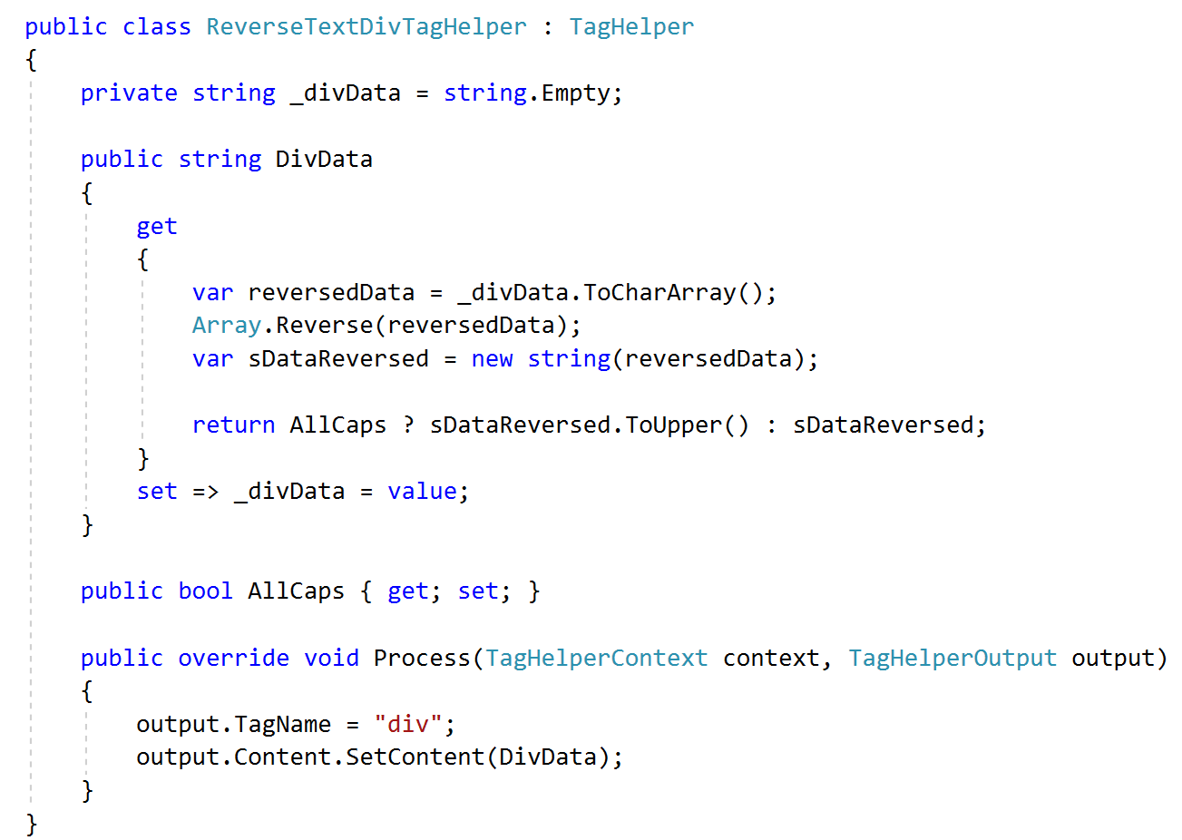
Tag Helper Example

Slide 21
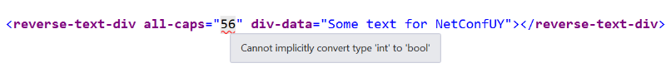
Tag Helper Example
From Razor
If we try to pass a number to all-caps property, we get

Slide 22

Tag Helper Example

Slide 23

ASP. Net Core – MVC6

Slide 24
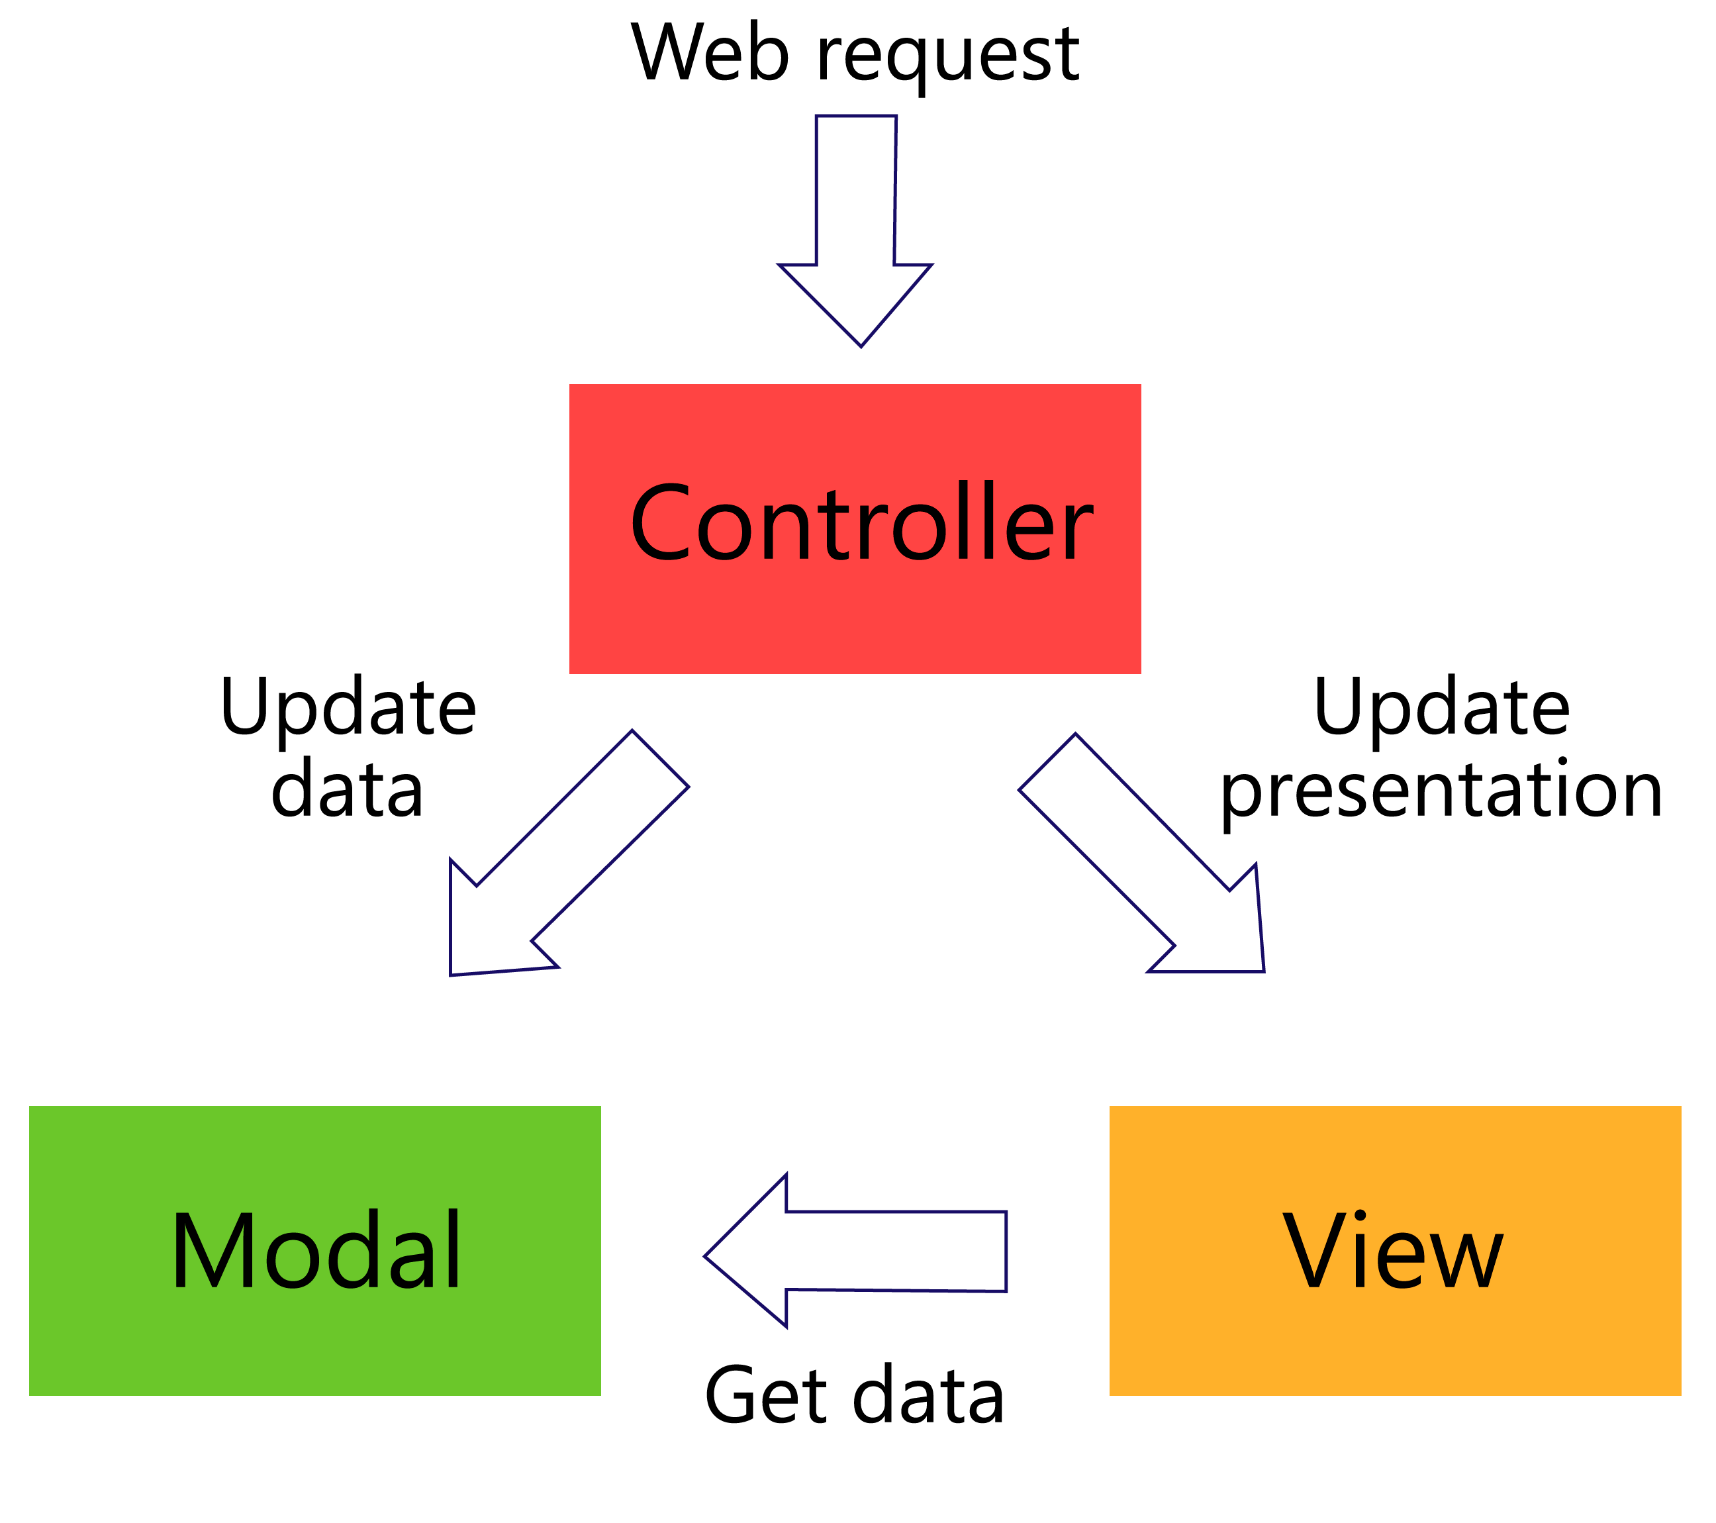
Mvc Pattern - Traditional MVC (In theory)

Slide 25
View Components – The reusable problem
What about the common views like menu, breadcrumbs and so on..
Solutions:
Child Actions
Html Helpers
View components are really a mesh of both HtmlHelper and child actions.

Slide 26
View components - Benefits
Dependency injection
Testing
Async full support

Slide 27
Using View Components
The view component class
A view component class can be created by any of the following:
Deriving from ViewComponent
Decorating a class with the [ViewComponent] attribute, or deriving from a class with the [ViewComponent] attribute
Creating a class where the name ends with the suffix ViewComponent

Slide 28
Using View Components
Fully supports constructor dependency injection
Does not take part in the controller lifecycle, which means you can't use filters in a view component

Slide 29
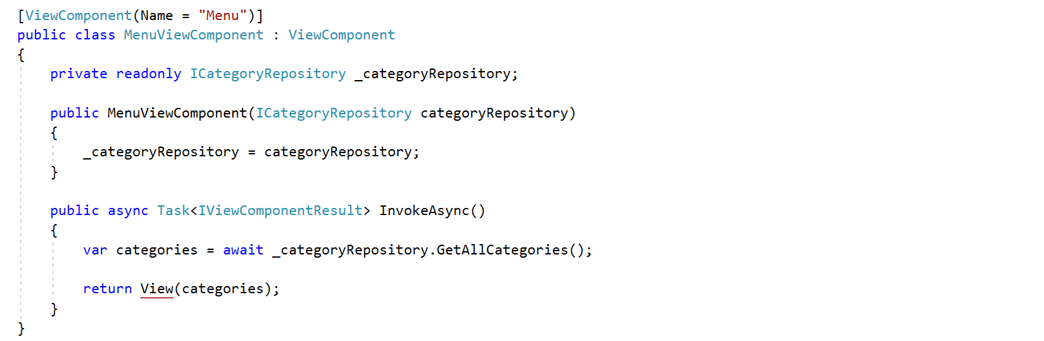
Using View Components

Slide 30
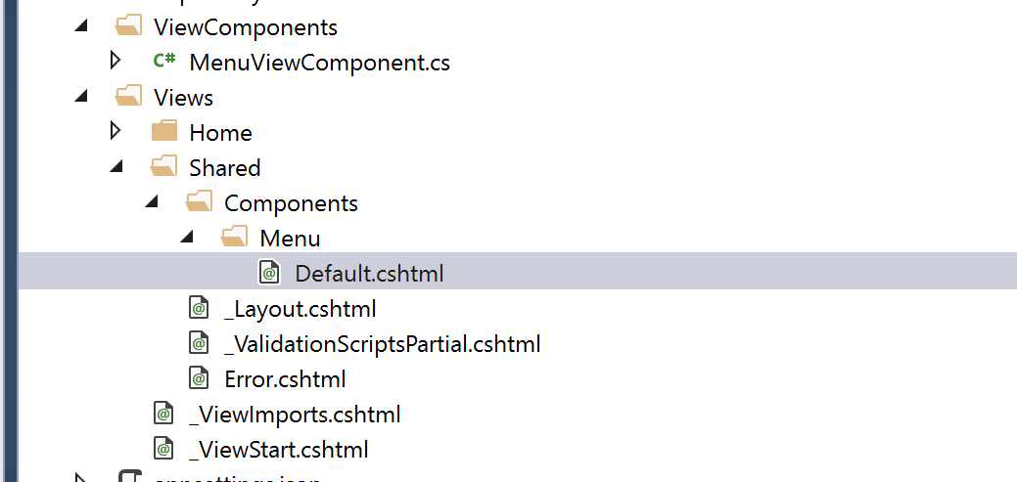
Using View Components - View search “Convention”
Views/<controller_name>/Components/<view_component_name>/<view_name>
Views/Shared/Components/<view_component_name>/<view_name>

Slide 31
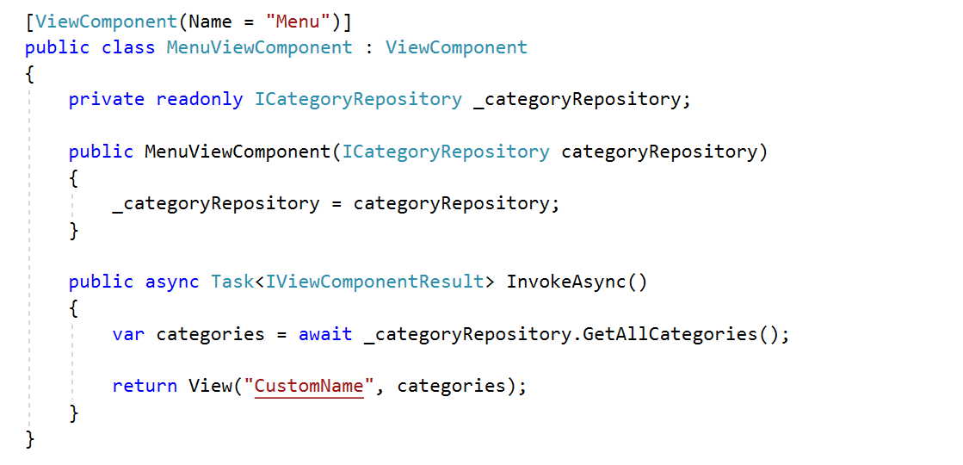
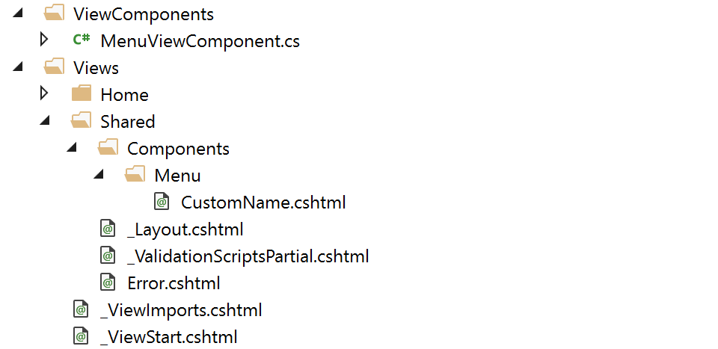
Using View Components - View search “Convention”
Default.cshtml is the default view name

Slide 32
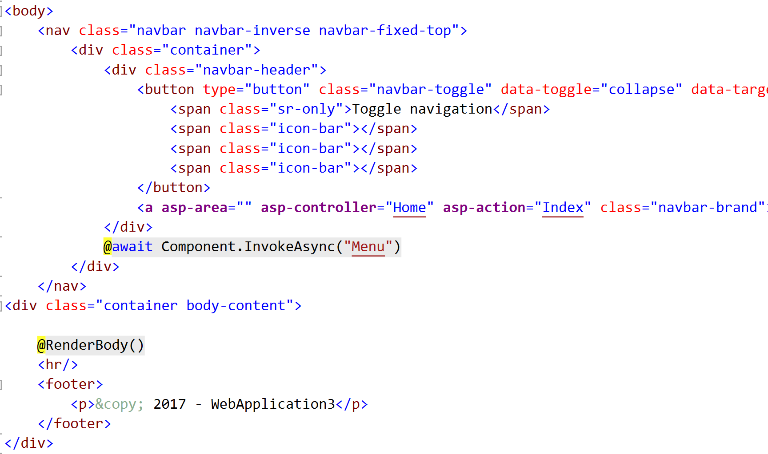
Using View Components - Invoking a view component

Slide 33
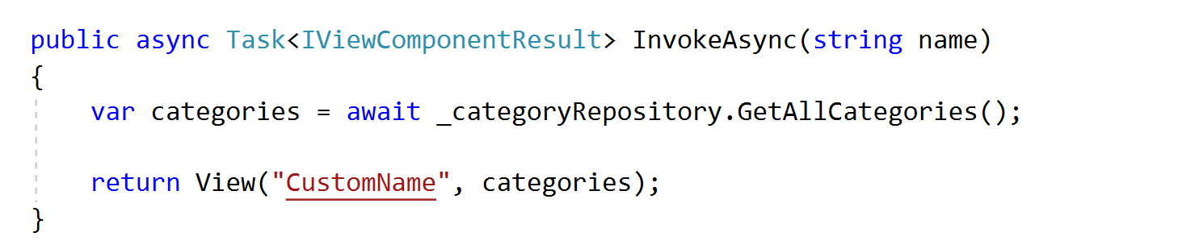
Using View Components - Pass data to the components

Slide 34
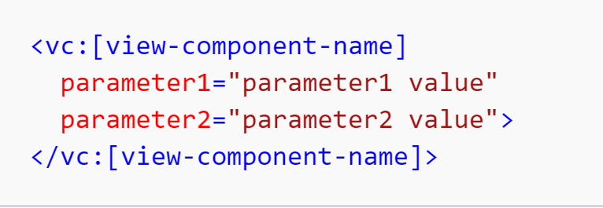
Using View Components - Invoking as a Tag Helper

Slide 35
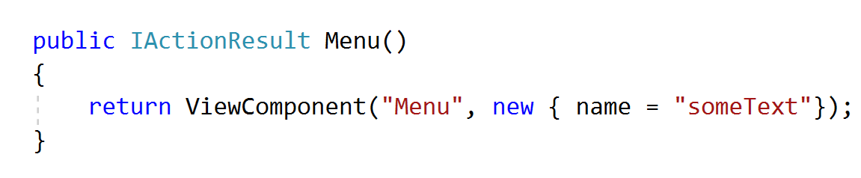
Using View Components - Invoking from a controller
While don’t define endpoints like controllers, you can easily implement an action that returns the content of a ViewComponentResult

Slide 36
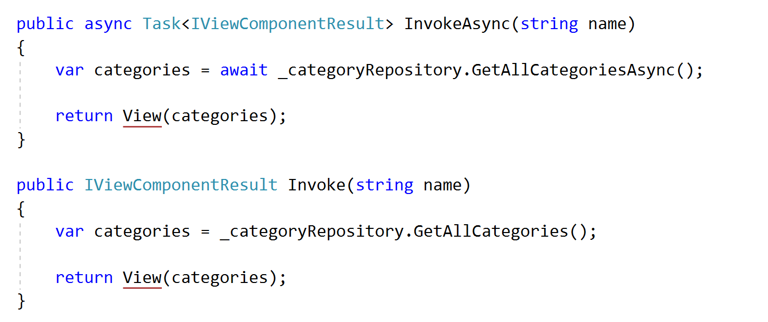
View Components – Async / Not Async methods

Slide 37
View Components -Some background info
Public
Non-abstract
Non generic
End with ViewComponent suffix or be decorated with ViewComponentAttribute

Slide 38
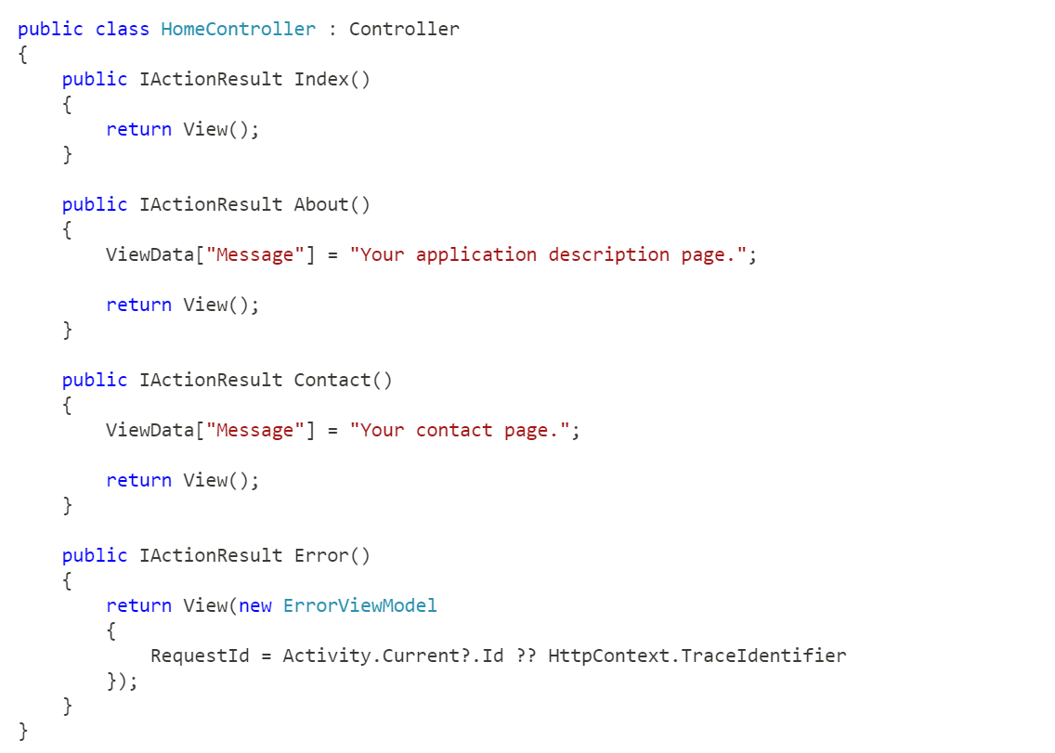
Razor Pages - Default Asp. Net MVC Template for Visual Studio.

Slide 39
Razor Pages – Evolution of Web Pages
Landing page with a smaller contact form
Page visitor counter
Current year In footer
And so on….

Slide 40
Using Razor Pages - Benefits
You have full ASP. Net DI Support, Redirect to Actions or pages
Binding property with BindProperty attribute
Async support for OnPostAsync ….OnGetAsync and custom Handlers
Razor full features
Using Layouts

Slide 41
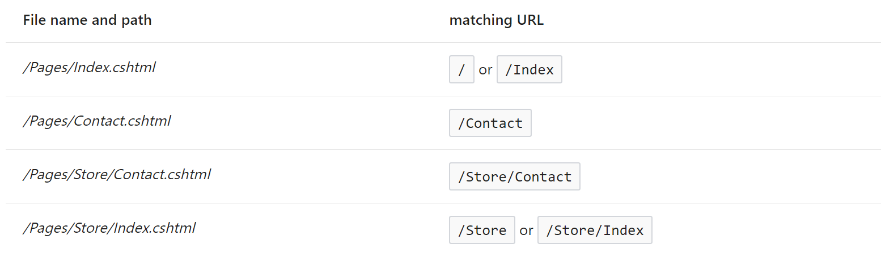
Razor Pages – Structure

Slide 42
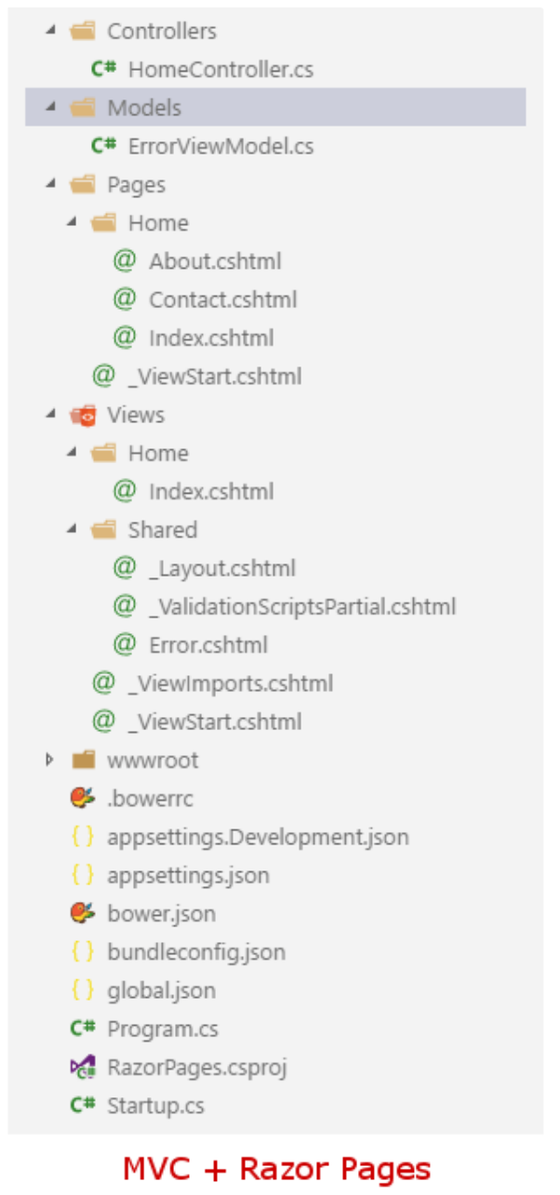
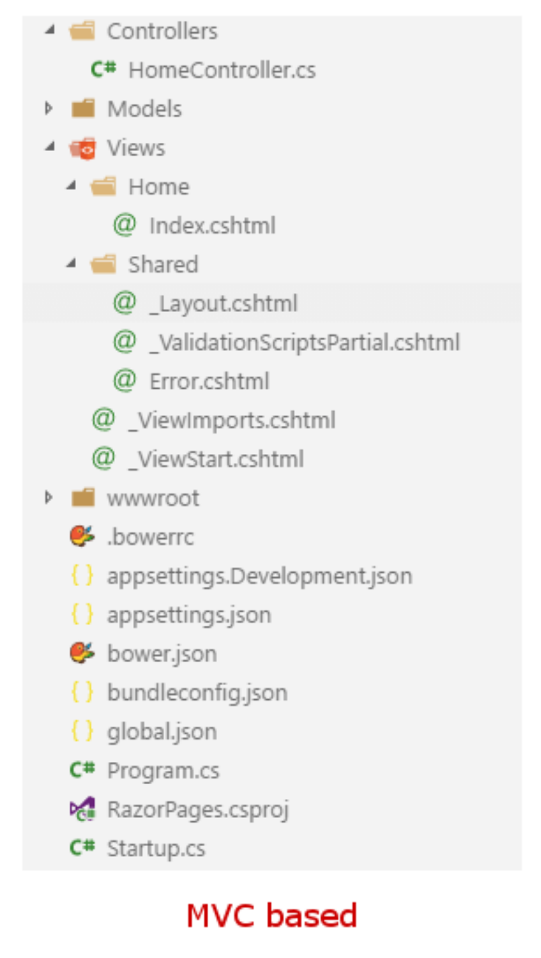
Razor Pages – Structure

Slide 43
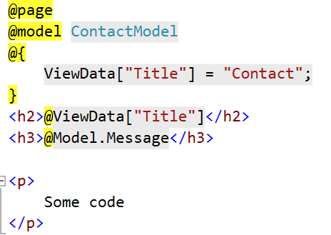
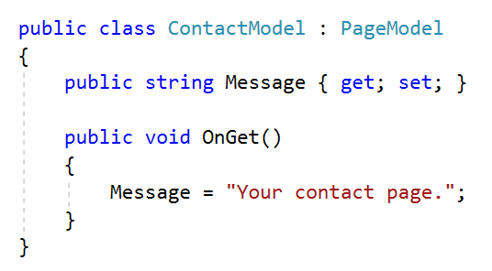
Using Razor Pages

Slide 44
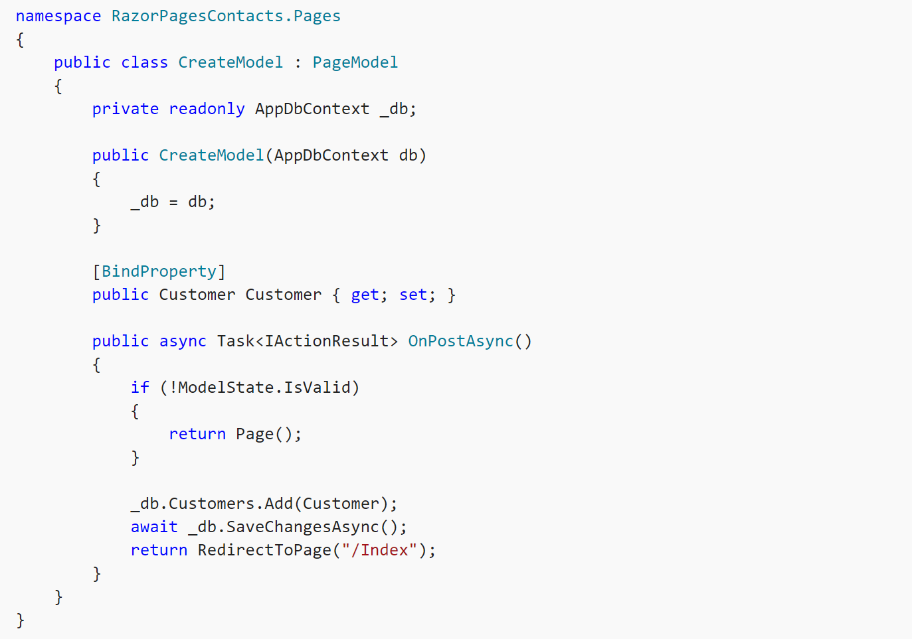
Using Razor Pages

Slide 45
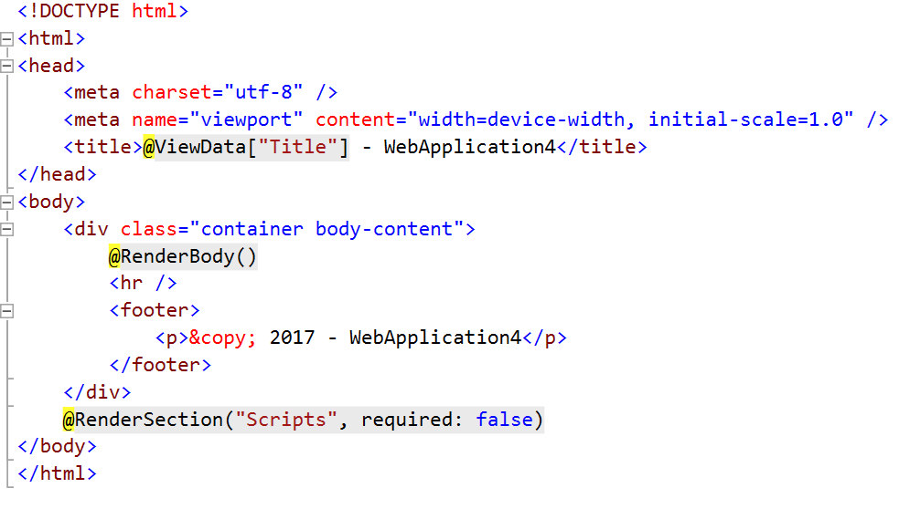
Using Razor Pages - Using layouts
/Pages/_Layout.cshtml

Slide 46
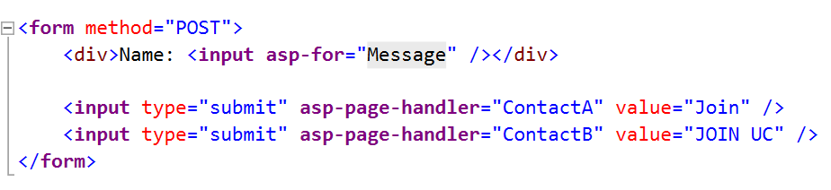
Using Razor Pages - Custom Page Handlers

Slide 47
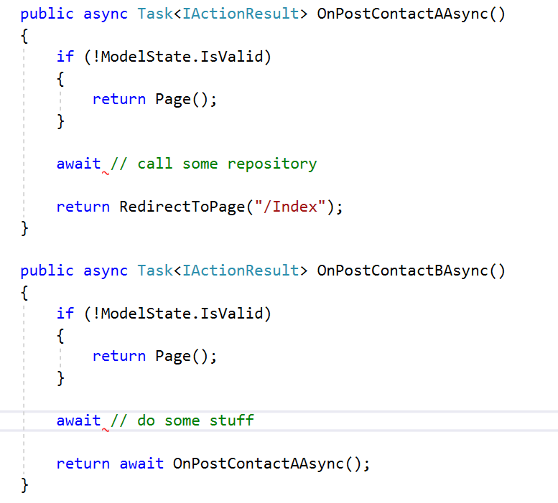
Using Razor Pages - Custom Page Handlers

Slide 48
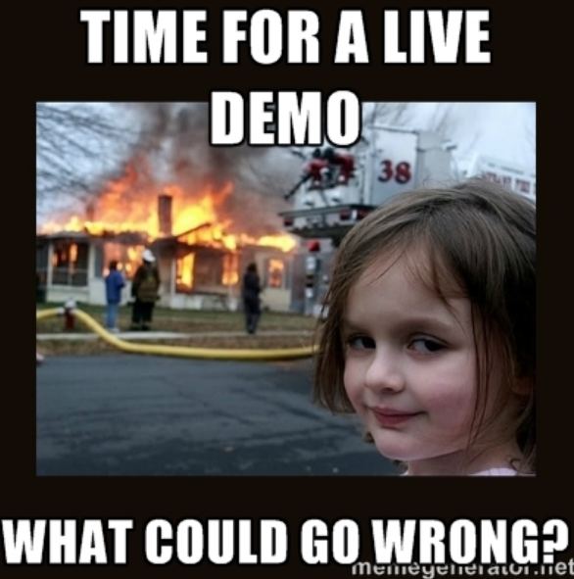
ASP. Net Core & MVC 6

Slide 49
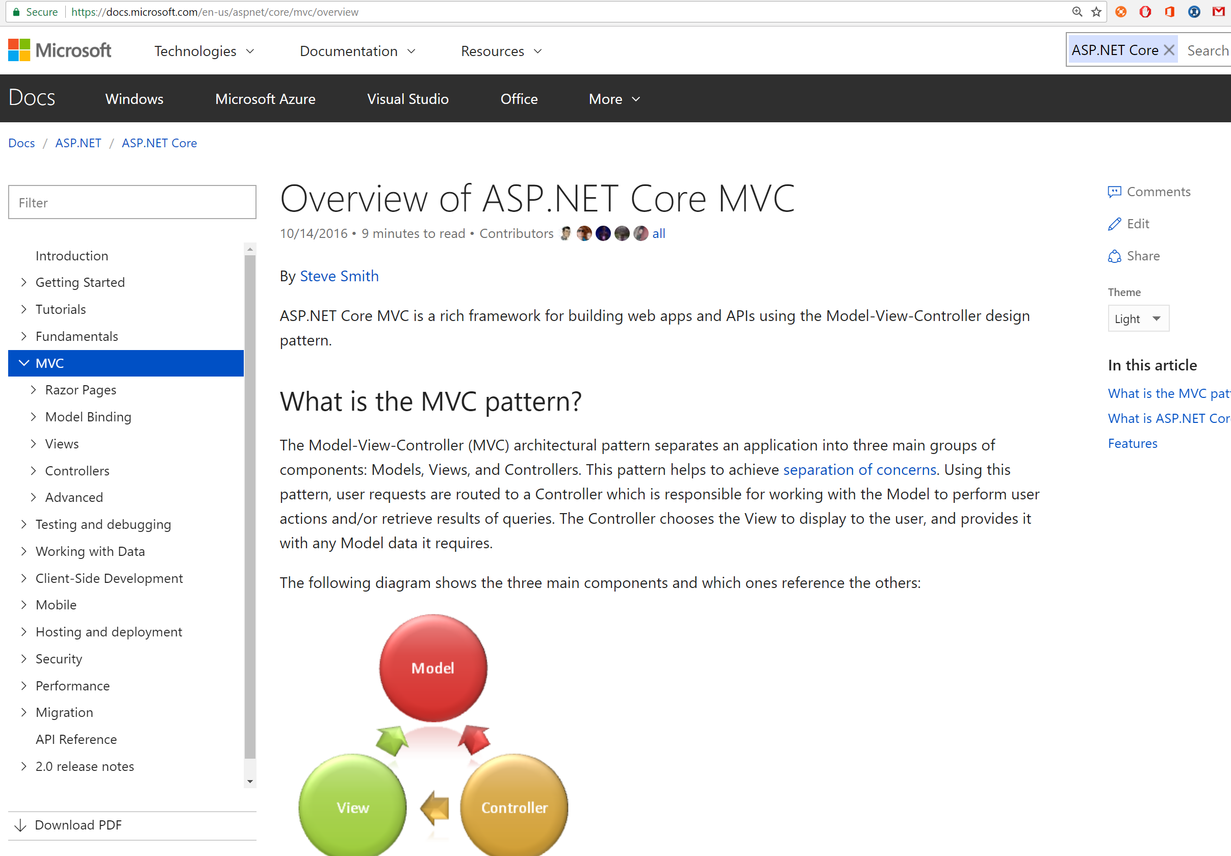
More about Asp .NET Core & MVC6
Official Documentation is complete & clear
https://docs.microsoft.com/en-us/aspnet/core/mvc/overview

Slide 50
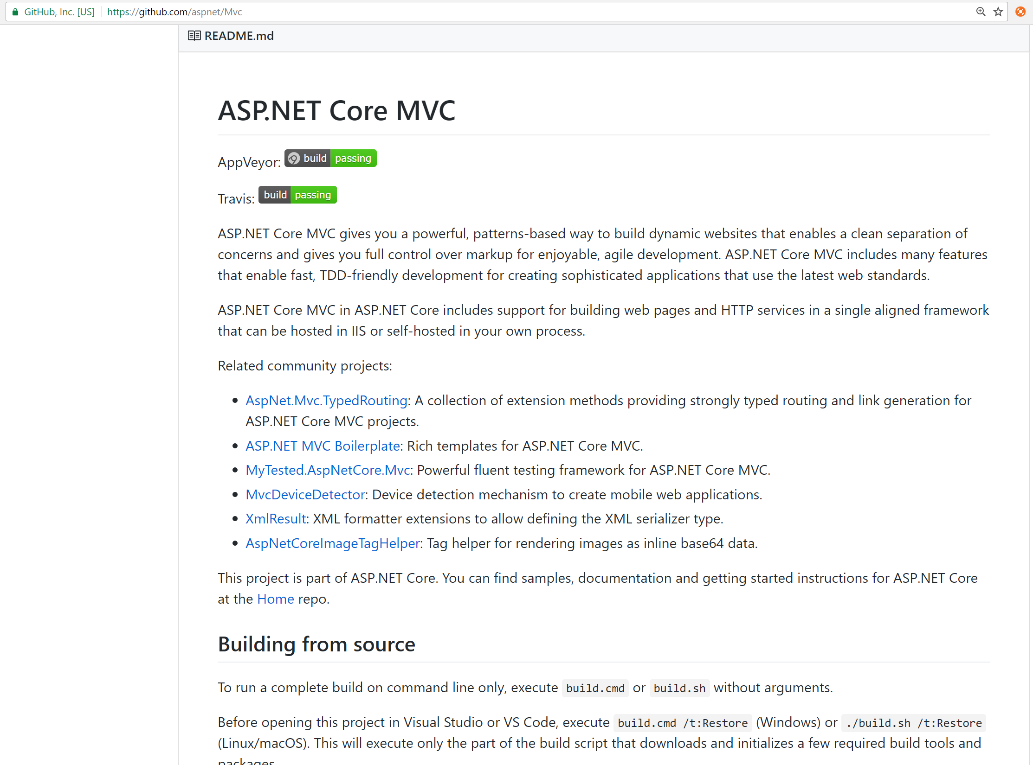
More about Asp .NET Core & MVC6
The code is 100% open source https://github.com/aspnet/Mvc

Slide 51
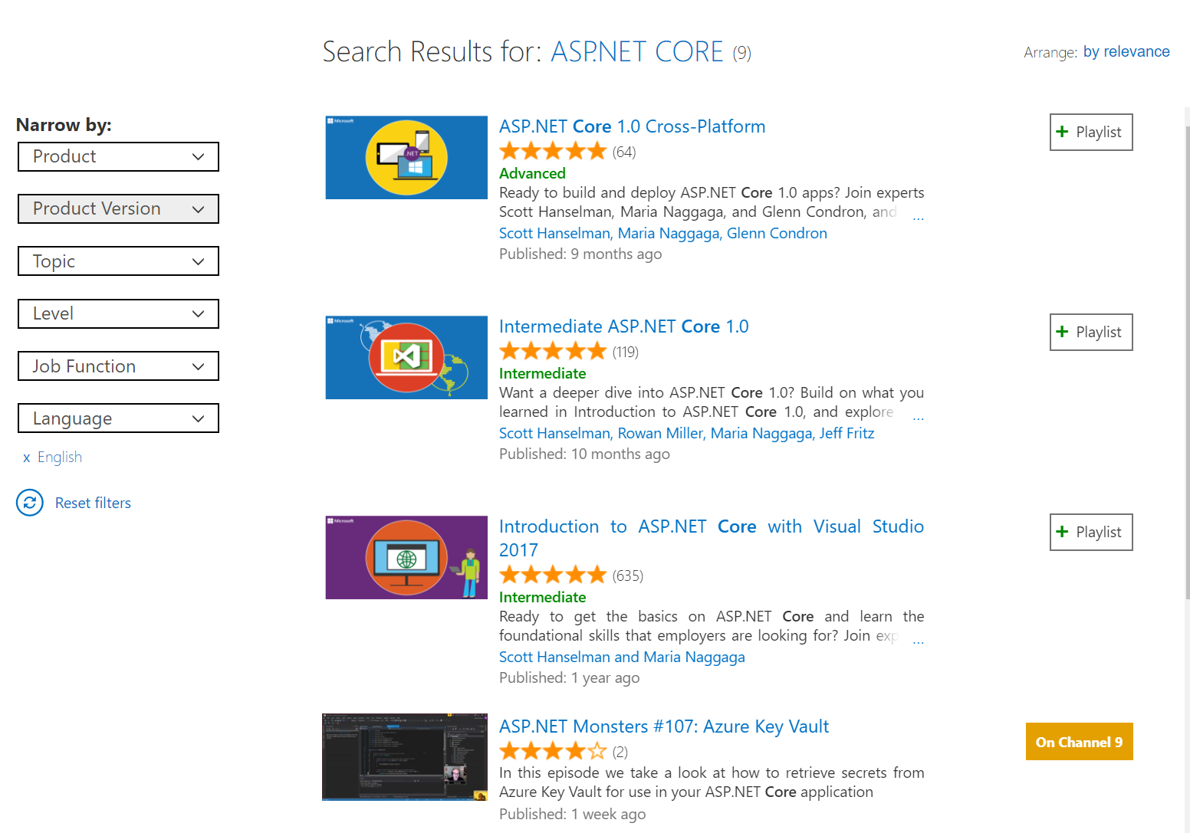
More about Asp .NET Core & MVC6
Awesome FREE courses in Microsoft Virtual Academy
https://mva.microsoft.com

Slide 52
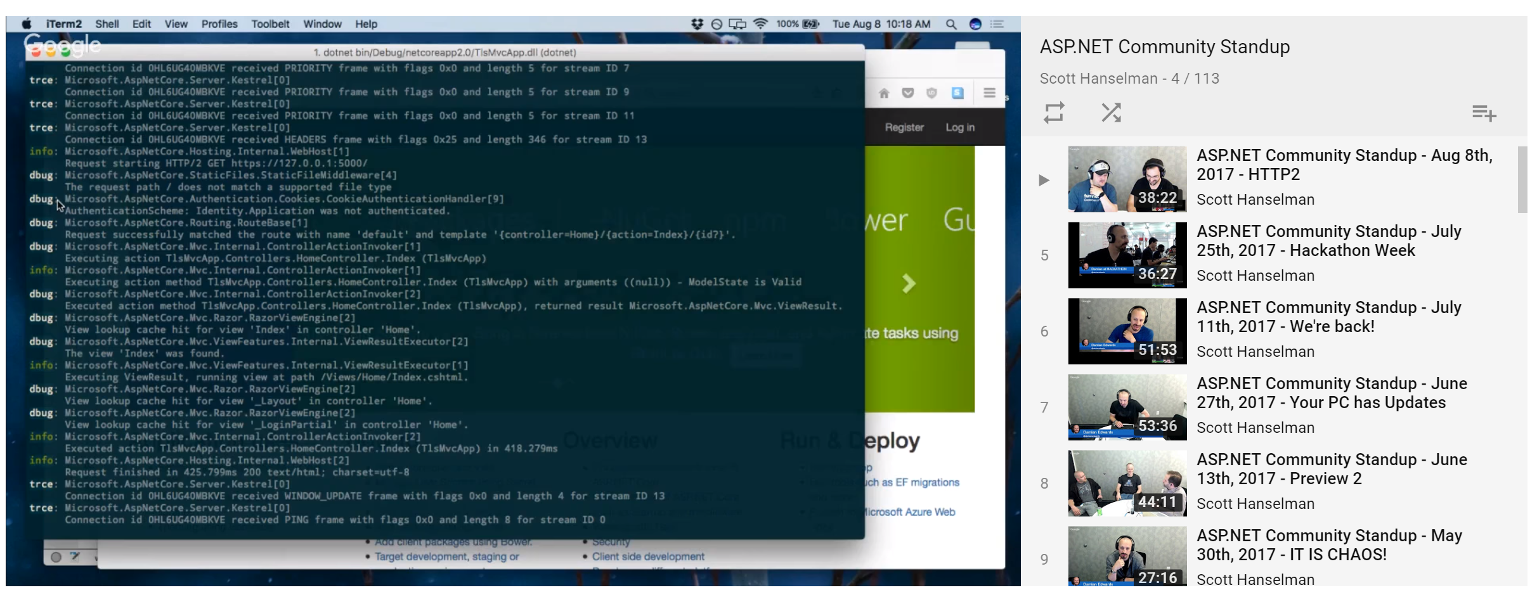
More about Asp .NET Core & MVC6
Asp. Net YouTube standup

Slide 53
More about Asp .NET Core & MVC6
Net Latam Slack net-latam.slack.com
Net Core Slack aspnetcore.slack.com
https://nbarbettini.gitbooks.io/little-asp-net-core-book/content/

Slide 55
Contact me!
David Revoledo
davidrevoledo@d-genix.com
@deirevoledo
https://www.linkedin.com/in/david-revoledo-01336984/

Slide 56


Asp.Net Core – MVC6
Thank You All

